Slide 1
Old Pareto had a chart

Slide 2
Getting 80% benefits of threat modelling with 20% of effort
”Innovative software and secure development practices are not a contradiction.”
You can find me at:
@IreneMichlin
20% effort 80%
results

Slide 3
1
What is Threat Modelling?
And why do I care?

Slide 4
Software-centric Threat Modelling
What are we building?
What can go wrong?
What are we going to do about that?
Have we done a good enough job?

Slide 5
Data Flow Diagrams

Slide 6
Threat | Property | Definition
Spoofing | Authentication | Impersonating something or someone else
Tampering | Integrity | Modifying data or code
Repudiation | Non-repudiation | Claiming to have not performed an action
Information Disclosure | Confidentiality | Exposing information to non-authorised party
Denial of Service | Availability | Deny or degrade service
Elevation of Privilege | Authorization | Gain capabilities without proper authorisation
Notes:
It’s just a mental scaffolding to find things. Needs to be augmented with threat libraries, CAPEC, MITRE

Slide 7
Spoofing
Notes:
Let me give you some examples
user can be spoofed by an attacker, and the external service provider does not know who the person getting the challenge questions really is.

Slide 8
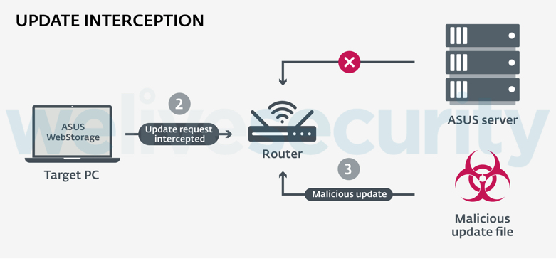
Tampering
Source: https://www.welivesecurity.com/2019/05/14/plead-malware-mitm-asus-webstorage

Slide 9
Other sources of threats
Attack trees
https://www.owasp.org/index.php/OWASP_Cloud_Security_Project
CWE: https://cwe.mitre.org/data/definitions/1008.html
SANS TOP25: https://www.sans.org/top25-software-errors
ATT&CK: https://attack.mitre.org
OWASP Top 10: https://www.owasp.org/index.php/Category:OWASP_Top_Ten_Project
Domain specific threat libraries
Notes:
Apart from brainstorming

Slide 10
Irene, are you kidding? Stop throwing extra work at us!

Slide 11
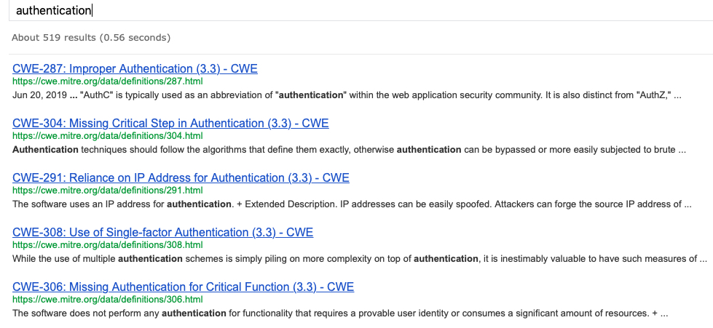
Can’t remember all of that all the time
Notes:
Each of these good links has several examples of “BAD”
OWASP cheat sheet on auth. Comes with about 50 pieces of advice, some with links to further reading.

Slide 12
Security Team
Need one example of “Good”
Notes:
Give me reference implementations reinforced by automated tests, or give me death.

Slide 13
2
Threat Modelling aids
Automated and semi-automated

Slide 14
Secure Development tools
Static Analysis
Dynamic Analysis
Fuzzing
Open Source Analysis
Code quality automated checks
Compliance automated checks

Slide 15
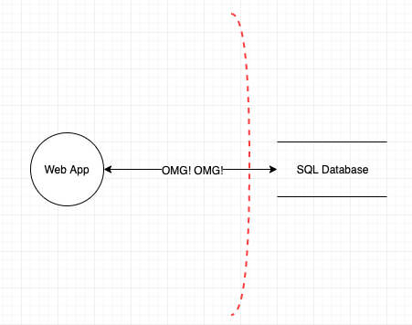
People’s time is precious
https://checkmarx.atlassian.net/wiki/spaces/KC/pages/78544949/Scan+Results+Example+v8.2.0

Slide 16
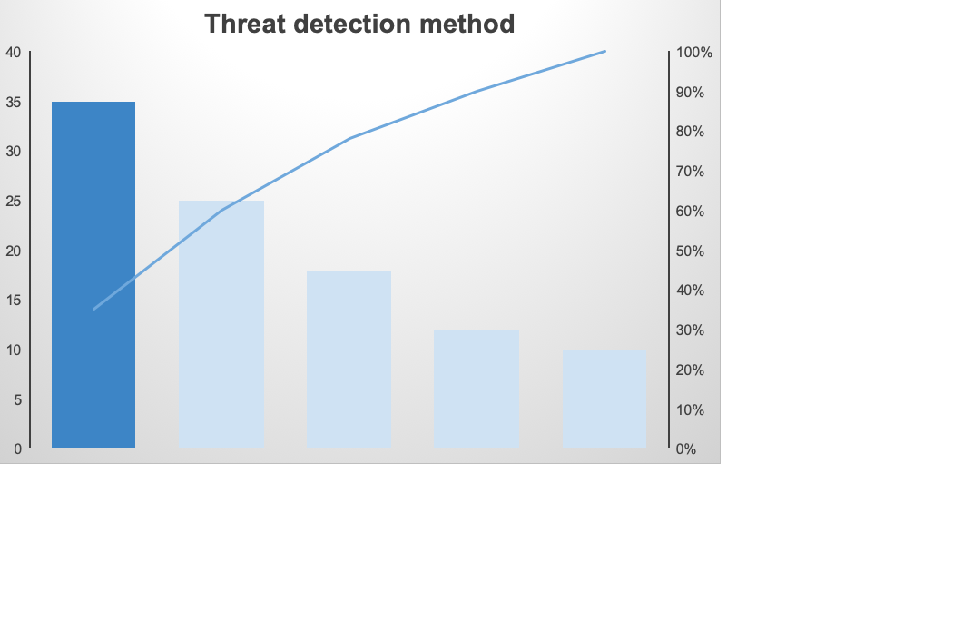
Tools – not TM specific

Slide 17


Threat modelling tools
Microsoft Threat Modeling tool
OWASP ThreatDragon
Threats Manager Studio
Tutamantic
IriusRisk
ThreatModeler
SDElements
SecuriCAD
$$

Slide 18
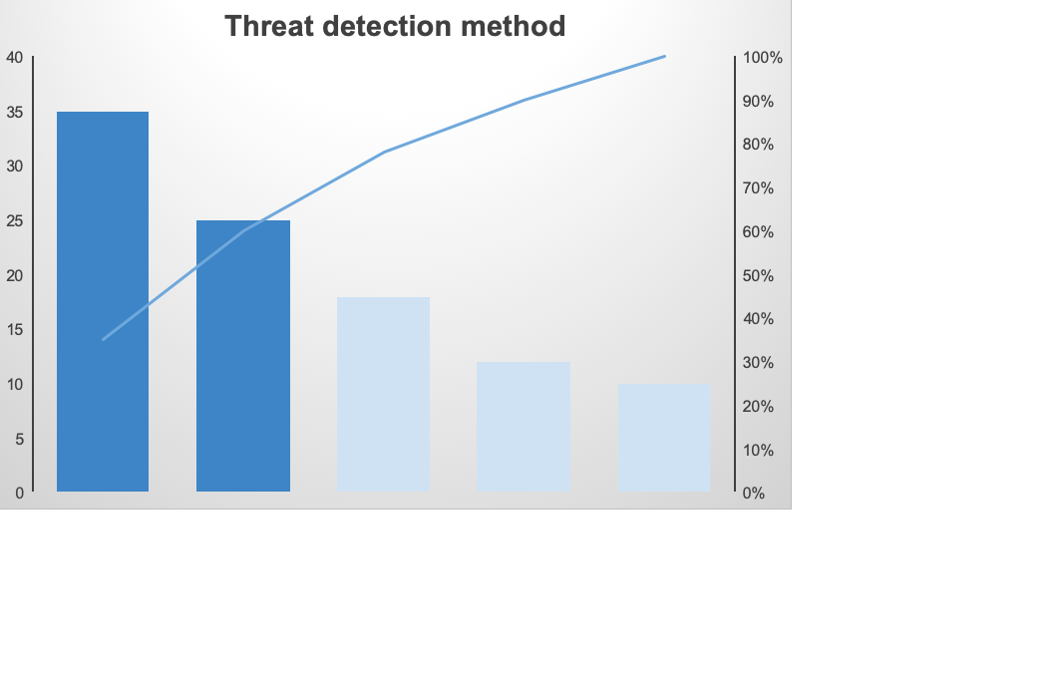
Tools – not TM specific
Tools – TM specific

Slide 19
3
DevSec Collaboration
Add Ops for extra marks

Slide 20
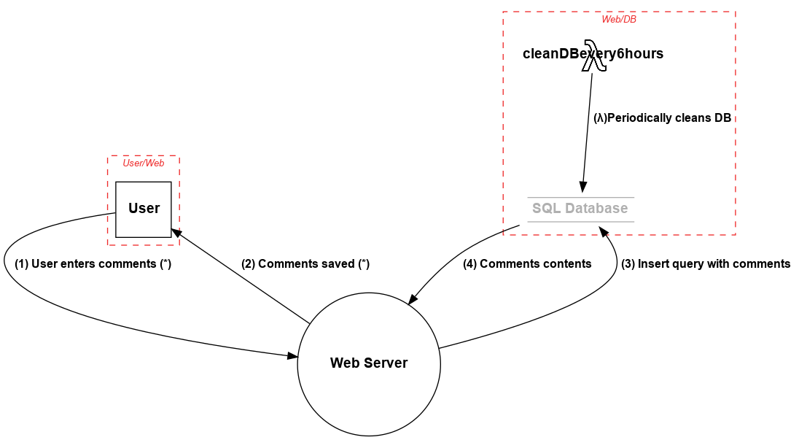
pytm: A Pythonic framework for threat modeling
https://github.com/izar/pytm
@izar_t
User_Web = Boundary("User/Web")
Web_DB = Boundary("Web/DB")
user = Actor("User")
user.inBoundary = User_Web
web = Server("Web Server")
web.OS = "CloudOS”
web.isHardened = True

Slide 21
ThreatPlaybook
https://github.com/we45/ThreatPlaybook
@abhaybhargav

Slide 22
https://threatspec.org
@zeroXten
annotate code
run threatspec
get TM report

Slide 23
Threagile
https://threagile.io
@cschneider4711
Threat Models as declarative YAML file
Data Assets
Components
Communication Links
Trust Boundaries
Generates diagrams and threat reports

Slide 24
materialize-threats
https://github.com/secmerc/materialize-threats
Parse draw.io diagrams
Enumerates threats
Suggests mitigations and tests

Slide 25
Good collaboration practices
Visibility into backlogs
Security work on THE backlog
Paved road:
Vetted libraries
Secret management
Image/VM/Container management
Design and implementation patterns
Clear trigger for TM session
Notes:
Number 1: it’s security responsibility to make the interactions not painful. Better yet, useful.

Slide 26
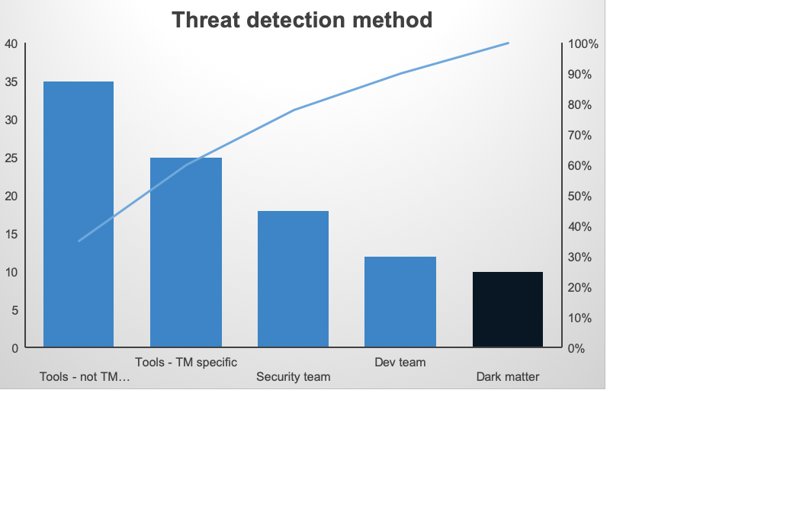

Slide 27
All models are wrong, but some are useful

Slide 28
https://www.threatmodelingmanifesto.org
Use the Manifesto as a guide to develop or refine a methodology that best fits your needs.

Slide 29
Thanks!
ANY QUESTIONS?
You can find me at:
@IreneMichlin irene221b@gmail.com

Slide 30
CREDITS
Special thanks to all the people who made and released these awesome resources for free:
Presentation template by SlidesCarnival
Photographs by Unsplash

